Slide 1
Let’s Make a Deal
Play a Game

Slide 2
Play 1

Slide 3
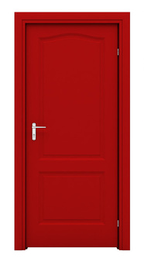
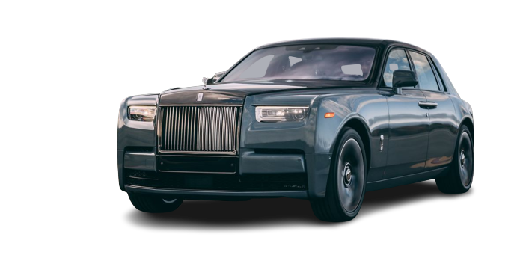
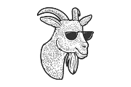
A
B
C

Slide 4

Choose
A
B
C

Slide 5
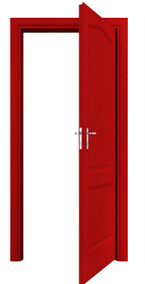
A
A
B
C

Slide 6
A
A
B
C

Slide 7
A
A
B
C

Slide 8
Play 2

Slide 9
A
B
C

Slide 10
Choose
A
B
C

Slide 11
A
A
B
C

Slide 12
A
A
B
C

Slide 13
A
A
B
C

Slide 14

Monty Hall Problem
“brain teaser, in the form of a probability puzzle
loosely based on the American television game show Let's Make a Deal and named after its original host, Monty Hall.

Slide 15
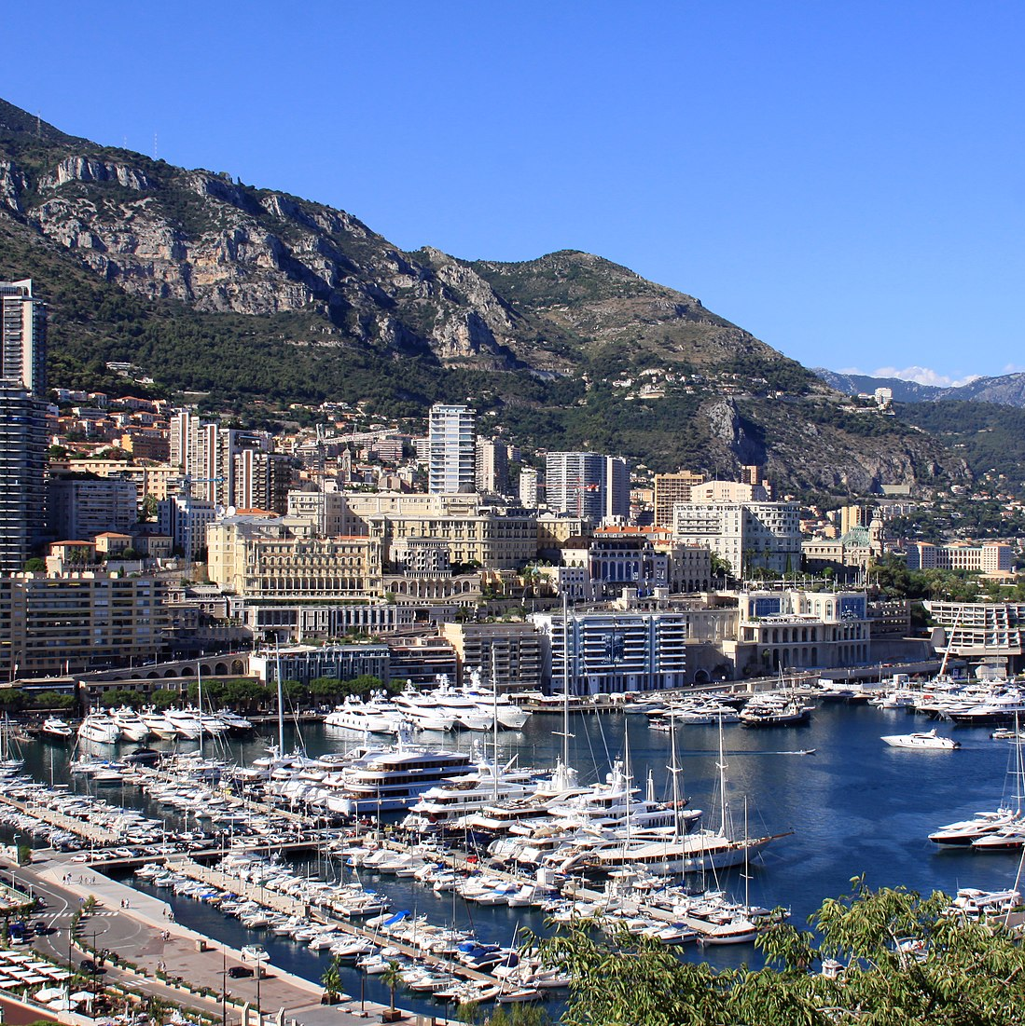
Monte Carlo
“random sampling to estimate probabilities and make predictions about uncertain outcomes.”

Slide 16
Simple Code

Slide 17
Code
from random import shuffle, choice
def monty_hall():
# Initialize the door with random allocation of the car i.e 1
door = [0, 1, 0]
shuffle(door)
# Randomy Choose among three Doors
door_choose = choice([0, 1, 2])
# Open the door after user chooses the for the 1st time that does not consist the car
goat_door = list()
for is_user_choice, is_goat_door in enumerate(door):
if is_goat_door == 0 and is_user_choice != door_choose:
goat_door.append(is_user_choice)
host_door_opened = choice(goat_door)

Slide 18
Code
# if a user does not switch the door and Gets CAR --> Success
if door[door_choose] == 1:
no_switch_success = True
else:
no_switch_success = False
# if a user switches the door and Gets CAR --> Success
left_door = set([0,1,2]).difference([door_choose, host_door_opened])
left_door = left_door.pop()
if door[left_door] == 1:
switch_success = True
else:
switch_success = False
return no_switch_success, switch_success

Slide 19
Code
def monte_carlo(n):
no_switch_success_num = 0
switch_success_num = 0
for simulations in range(n):
ns, ss = monty_hall()
no_switch_success_num += ns
switch_success_num += ss
print("The number of simulations: {}".format(n))
print("The number of success on switch: {}%".format((switch_success_num/n)*100))
print("Number of success on non-switch: {}%".format((no_switch_success_num/n)*100))
number_of_trials = int(input("Enter the number of simulation (Large number up to Thousands -> 000)"))
monte_carlo(number_of_trials)

Slide 20
OOP CODE

Slide 21
Code
import random
class MontyHallSimulation:
def __init__(self):
self.doors = [0, 0, 1] # 0 represents a goat and 1 represents a car
random.shuffle(self.doors) # shuffle the doors randomly
self.choice = None
self.goat_door = None
self.switch_choice = None
def choose_door(self):
self.choice = random.randint(0, 2) # randomly choose a door
self.goat_door = random.choice([i for i in range(3) if i != self.choice and self.doors[i] == 0]) # host opens a goat door

Slide 22
Code
def switch(self):
self.switch_choice = next(i for i in range(3) if i != self.choice and i != self.goat_door) # switch to the other unopened door
def win_no_switch(self):
return self.doors[self.choice] == 1 # return True if the contestant wins without switching
def win_switch(self):
return self.doors[self.switch_choice] == 1 # return True if the contestant wins by switching

Slide 23
Code
class MontyHall:
def __init__(self, num_simulations):
self.num_simulations = num_simulations
self.wins_no_switch = 0
self.wins_switch = 0
def run_simulations(self):
for i in range(self.num_simulations):
simulation = MontyHallSimulation()
simulation.choose_door()
if simulation.win_no_switch():
self.wins_no_switch += 1
simulation.switch()
if simulation.win_switch():
self.wins_switch += 1

Slide 24
Code
def print_results(self):
print(f"Results after {self.num_simulations} simulations:")
print(f"Win percentage without switching: {100 * self.wins_no_switch / self.num_simulations:.2f}%")
print(f"Win percentage with switching: {100 * self.wins_switch / self.num_simulations:.2f}%")
monty_hall = MontyHall(1000)
monty_hall.run_simulations()
monty_hall.print_results()

Slide 25
Chart: Result of Simulation

Slide 26
Table: Probability
Behind door 1 | Behind door 2 | Behind door 3 | Result if staying at door #1 | Result if switching to the door offered
Goat | Goat | Car | Wins goat | Wins car
Goat | Car | Goat | Wins goat | Wins car
Car | Goat | Goat | Wins car | Wins goat

Slide 27
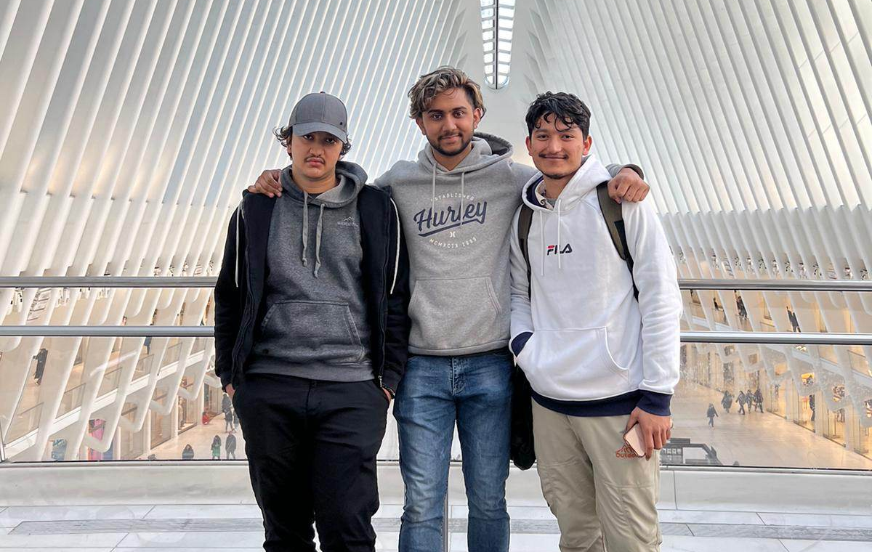
Team

Slide 28




Thank you
Manoj Nath Yogi
manoj.nathyogi@bison.howard.edu
Aryan Bagale
aryan.bagale@bison.howard.edu
Bijay Pandey
bijay.pandey@bison.howard.edu

